Slide 1
Thanksgiving dinner

Slide 2
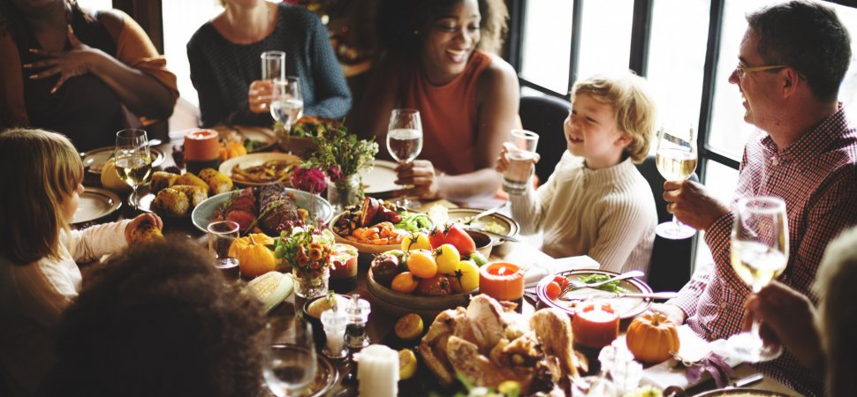

Slide 3
Saying thanks around our Thanksgiving table is the core of Thanksgiving Day.

Slide 4
Thanksgiving dinner is the largest eating event in the United States; people eat more on Thanksgiving than on any other day of the year.

Slide 5
Turkey is the most common main dish of a Thanksgiving dinner, to the point where Thanksgiving is sometimes colloquially called “Turkey Day.” Most Thanksgiving turkeys are stuffed with a bread-based mixture and roasted.

Slide 6
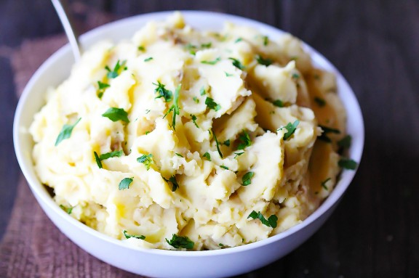
Side dishes:
Mashed potatoes

Slide 7
Sweet potatoes casserole, Green bean casserole, Stuffing

Slide 8
Turkey gravy, Corn casserole, Cranberry orange sauce

Slide 9
Pumpkin pie, Apple pie, Cranberry cheesecake pie

Slide 10
Drinks

Slide 11
Coctails, eggnog, beer

