Slide 1
Fun facts
About thanksgivng

Slide 2
About 46 million turkeys are cooked for Thanksgiving each year.

Slide 3
President George H.W. Bush pardoned the first turkey in 1989 after he noticed the 50-pound bird at his official Thanksgiving proclamation looked a little antsy.

Slide 4
But what happens to that lucky bird that gets to squawk another day? In 2005 and 2009, the turkeys went to Disneyland and Walt Disney World parks to serve as grand marshal in their annual Thanksgiving parades.

Slide 5
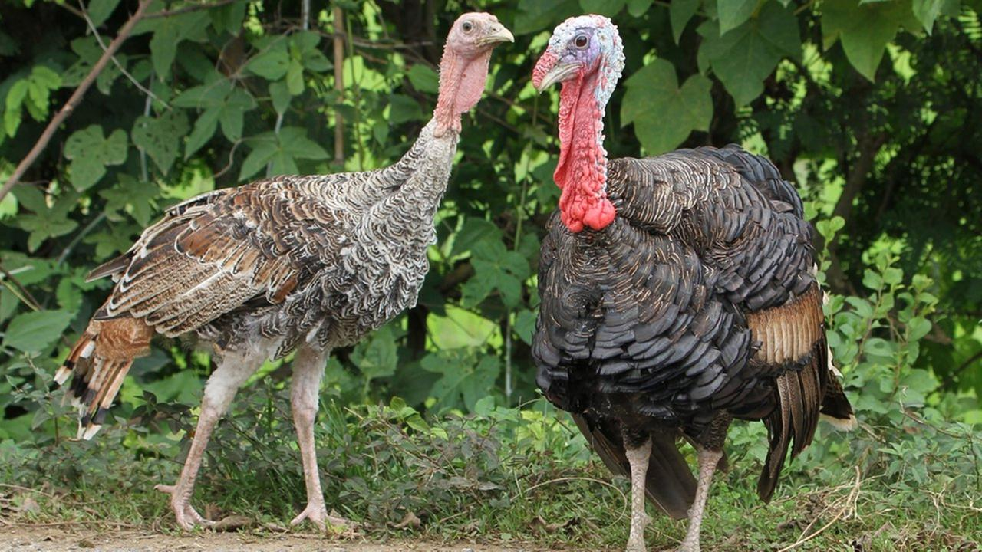
Only male turkeys actually gobble.
Female turkeys cackle instead.
So if you're trying to figure out
whether a turkey's a male or a female,
just wait until they open their beaks.
.

Slide 6
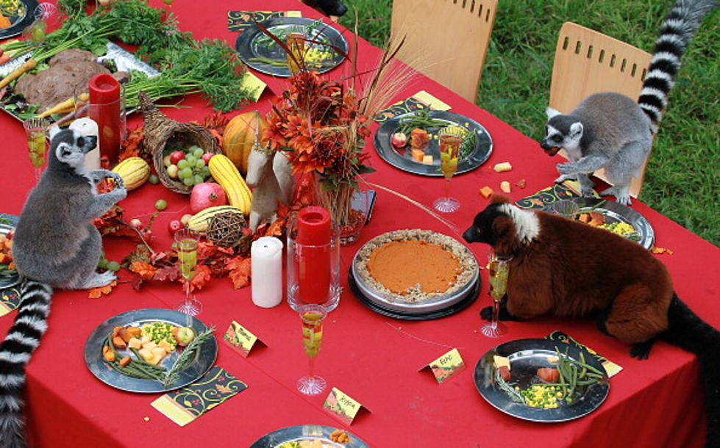
Most Americans like Thanksgiving leftovers more than the actual meal.

Slide 7
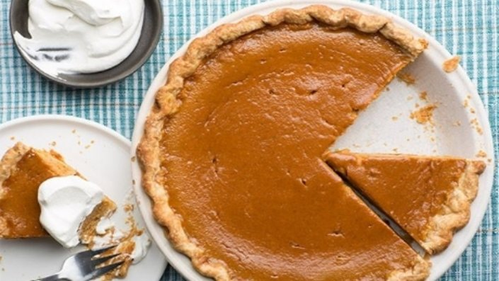
An estimated 50 million pumpkin pies are eaten on Thanksgiving.

Slide 8
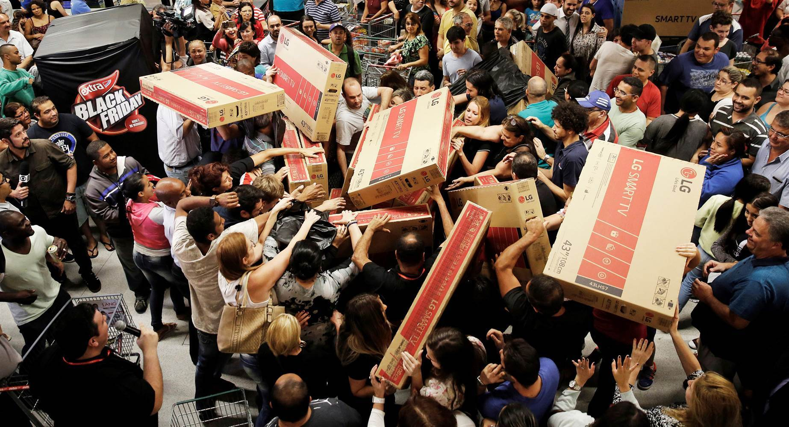
Over 32 million people begin Black Friday shopping on Thanksgiving.

Slide 9
The Butterball Turkey Talk Line answers almost 100,000 calls each season.
So many people roast a turkey just once a year, and understandably need a little help. In 2016, the company's popular cooking crisis management team also introduced a 24-hour text message line for the lead-up into the big day. So if you're wondering why the turkey isn't turning out quite the way you want it, fear not. Help is just a call or a text message away.

Slide 10
Thank you!!

